Slide 1


Telangana Growth Analysis
Telangana Growth Analysis

Slide 2

INTRODUCTION
Telangana is a state located in southern India. It was officially formed as the 29th state of India on June 2, 2014, after a long-standing demand for its separate identity from the combined Andhra Pradesh state
The region has a rich historical and cultural heritage, and its capital city is Hyderabad, which also serves as the joint capital for the neighboring state of Andhra Pradesh for a period of time after the bifurcation

Slide 3
INTRODUCTION
Python
Stamp Registration
Telangana
Growth
Analysis
Power BI
Transportation
Power Point
TS pass

Slide 4

STAMP REGISTRATION
REVENUE
Document Registration
E-stamps
Challans

Slide 5


How does the revenue generated from document registration vary across districts in Telangana? List down the top 5 districts that showed the highest revenue growth between FY 2019 and 2022.

Slide 6
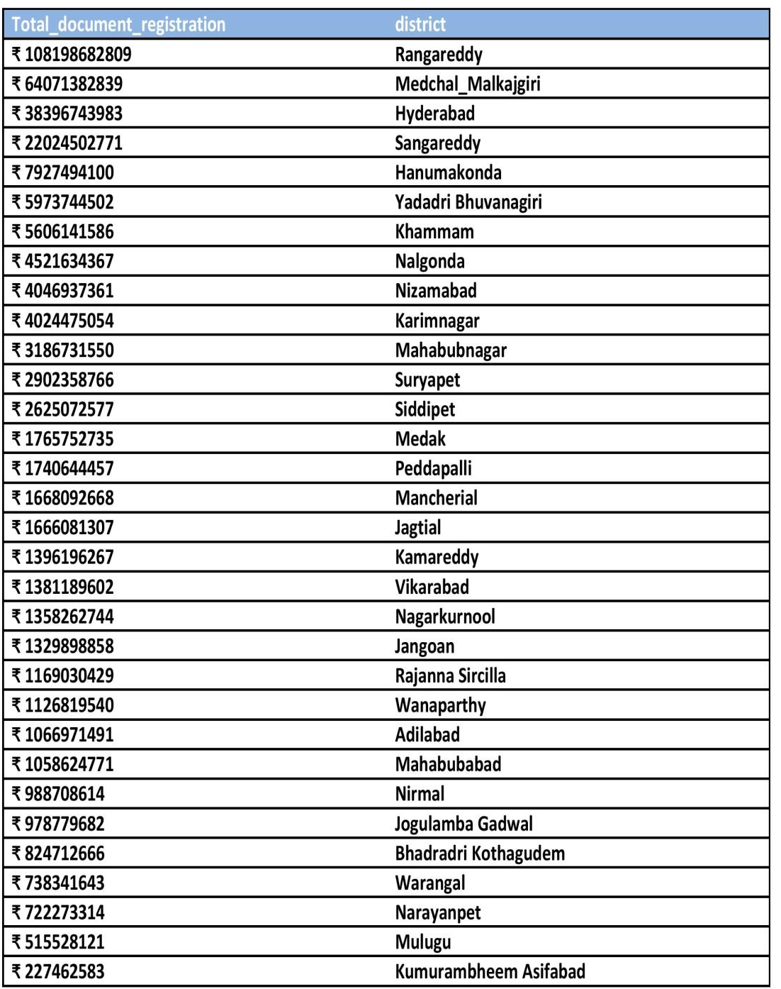
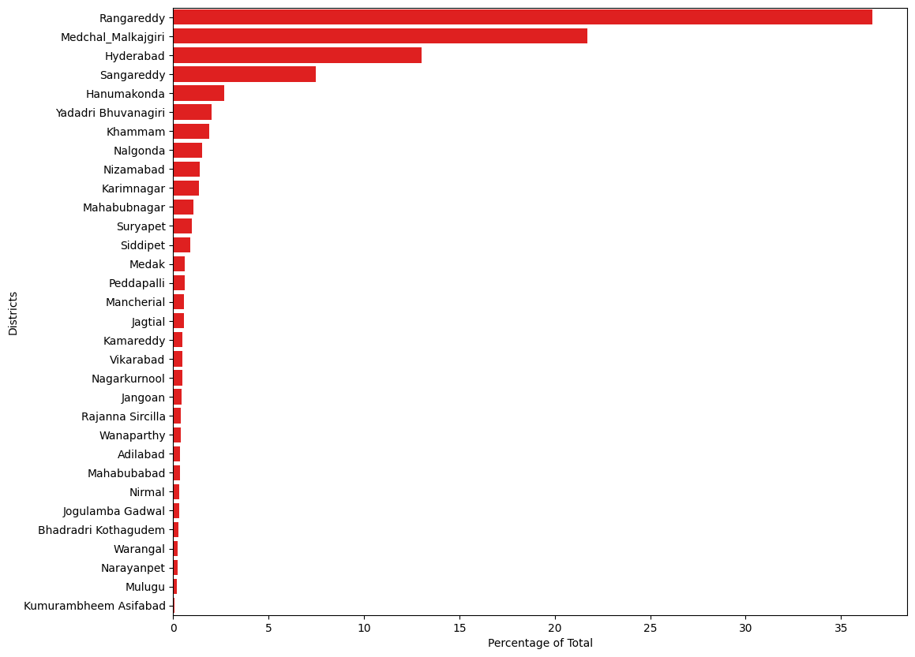
Revenue Generated From document registration across various districts

Slide 7
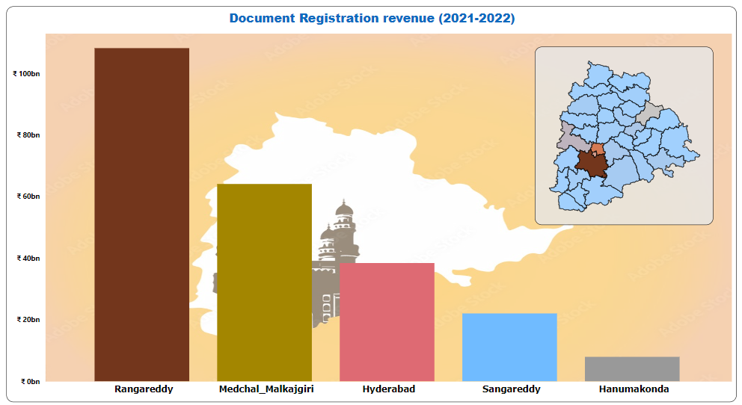
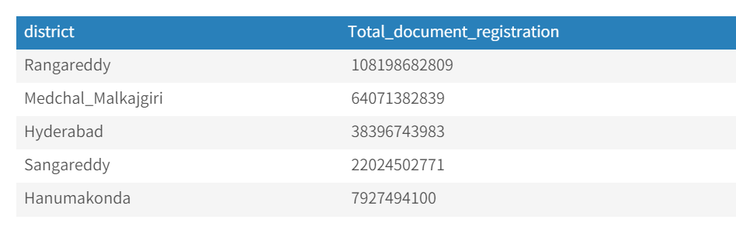
top 5 districts that showed the highest revenue growth between FY 2019 and 2022

Slide 8
How does the revenue generated from document registration compare
to the revenue generated from e-stamp challans across districts

Slide 9
Revenue Generation from state refers to the stamp duty, transfer duty, registration fees and user charges paid by the public to register any deed. User now has the convenience of paying the stamp duty from anywhere. This system is user friendly, hassle free and convenient as the citizen saves time and pays the stamp duty from the comfort of his home/office/anywhere.

Slide 10
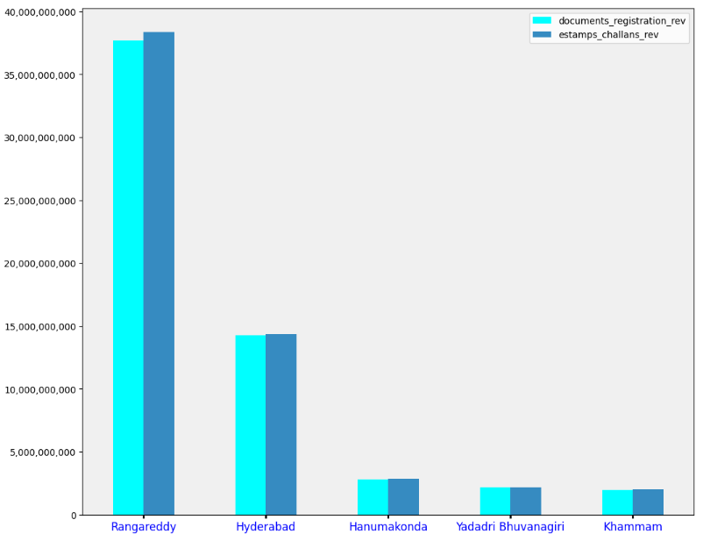
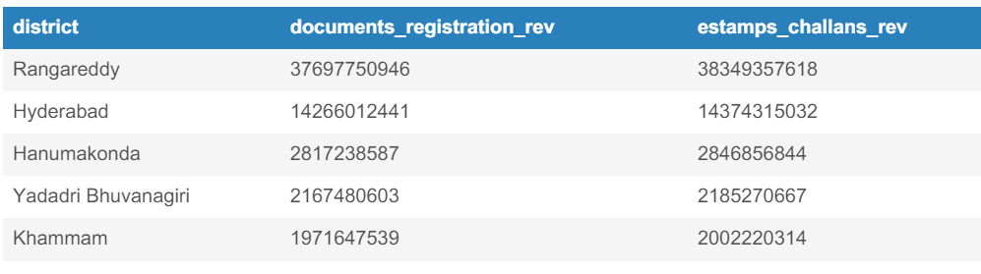
List down the top 5 districts where e-stamps revenue contributes significantly more to the revenue than the documents in FY 2022

Slide 11
Is there any alteration of e-Stamp challan count and document
registration count pattern since the implementation of e-Stamp
challan? If so, what suggestions would you propose to the
government

Slide 12
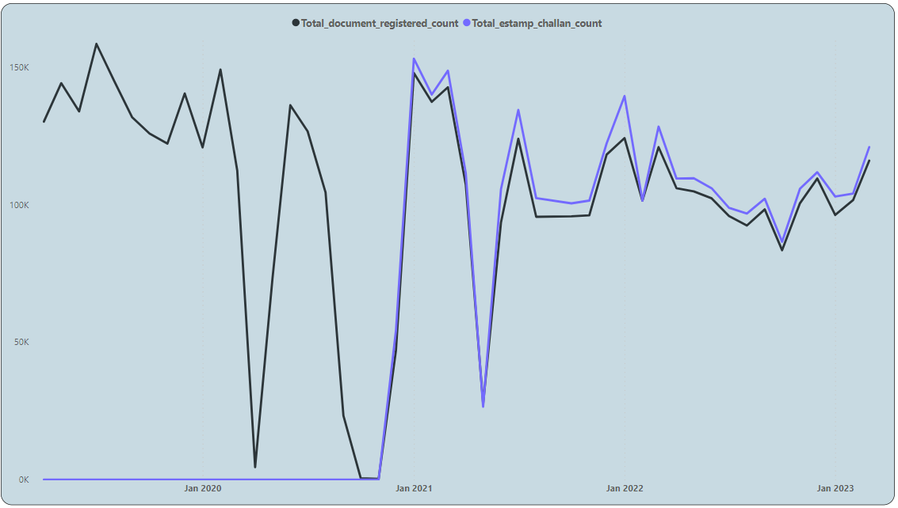

Slide 13
Categorize districts into three segments based on their stamp
registration revenue generation during the fiscal year 2021 to 2022

Slide 14
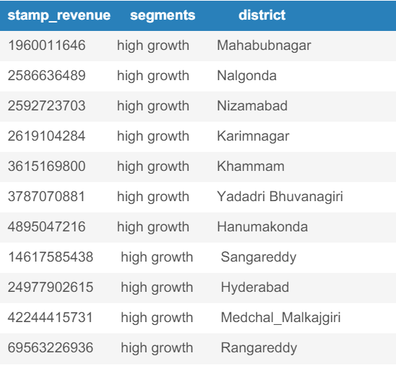
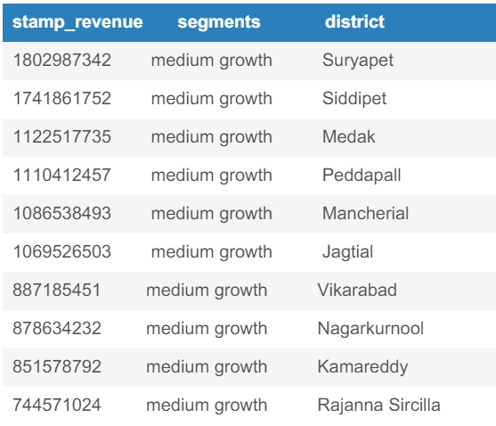
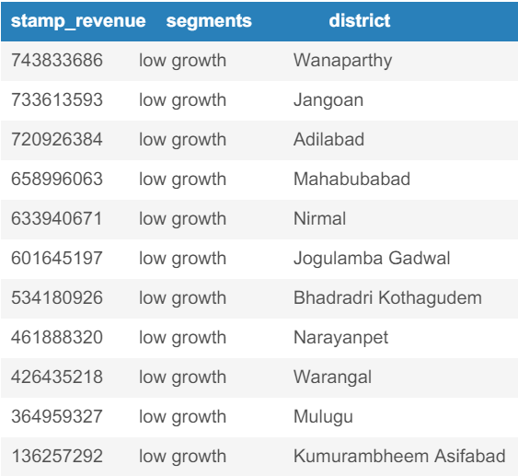
The Highest Growth District is RANGAREDDY (69Bn)
The Lowest Growth district is Kumurambheem Asifabad(13.257 Million)

Slide 15

TRANSPORTATION

Slide 16

How does the distribution of vehicles vary by vehicle class (MotorCycle, MotorCar, AutoRickshaw, Agriculture) across different districts

Slide 17
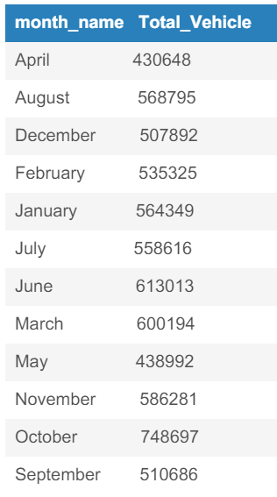
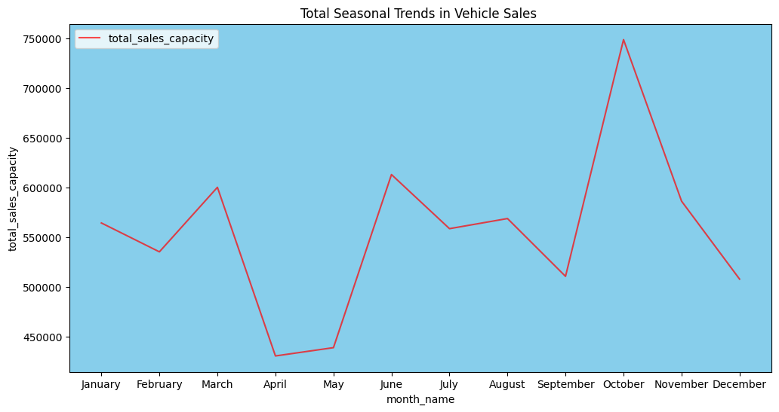
Correlation between vehicle sales and specific months

Slide 18
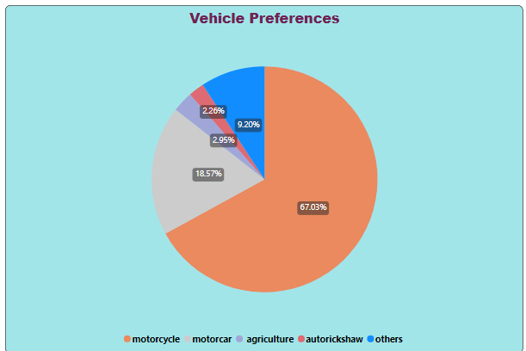
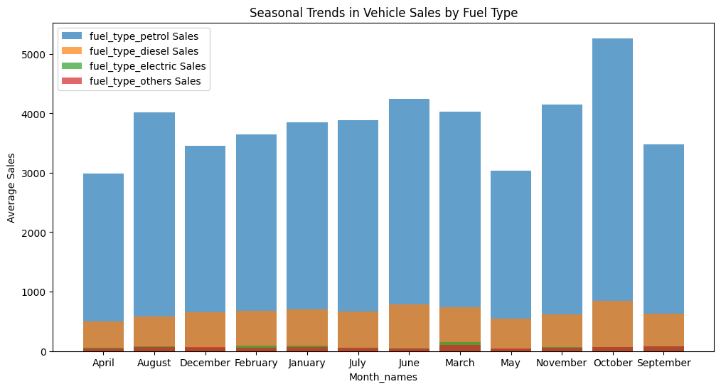
Vehicle Preference as per total sales
Seasonal Trends in vehicle sales as per fuel type

Slide 19
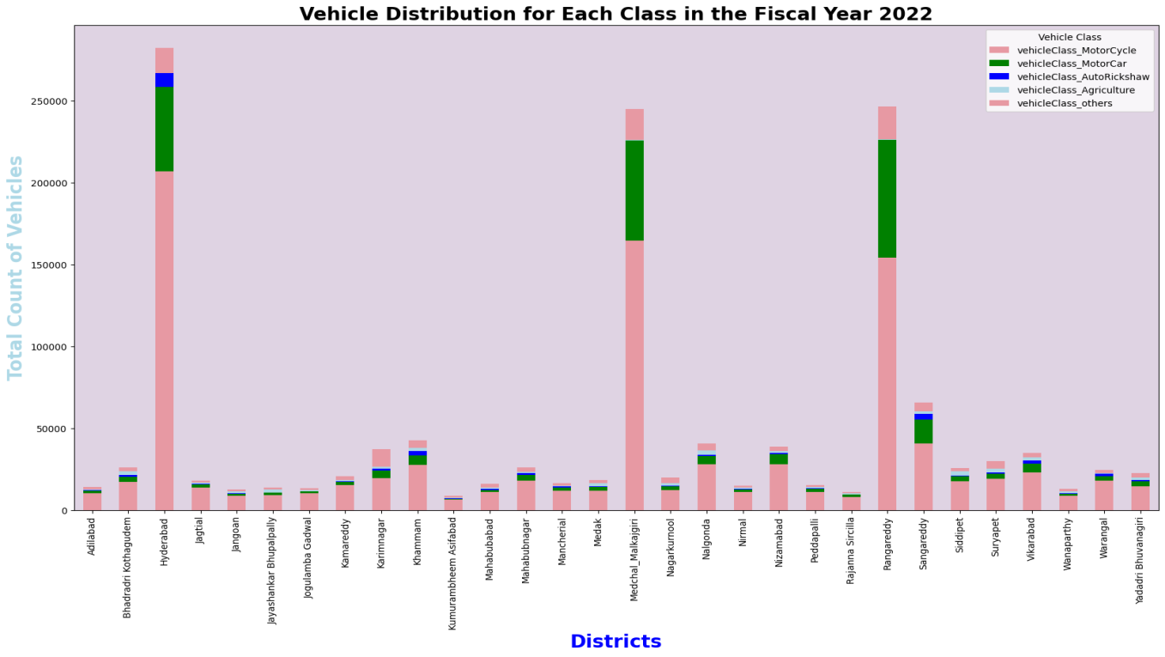
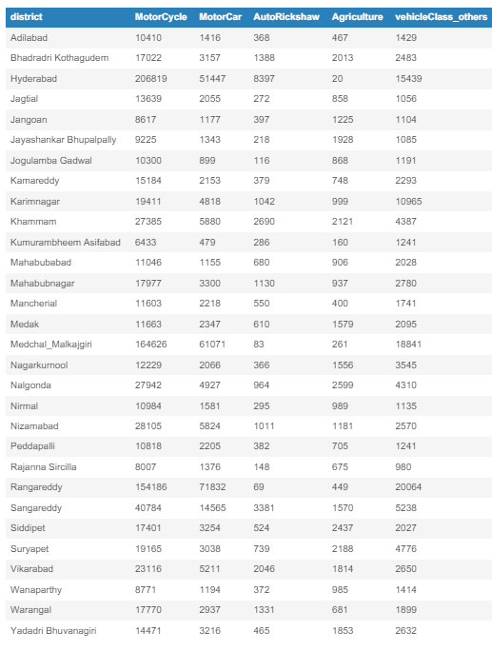
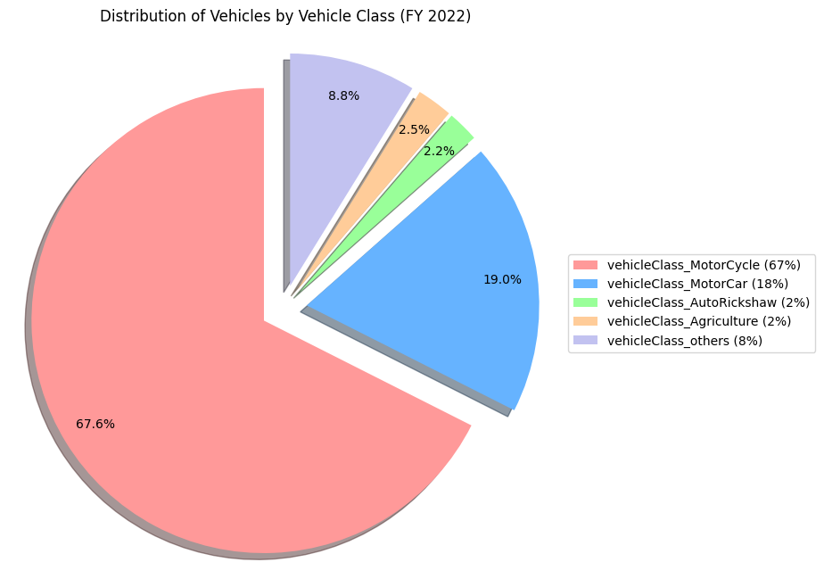

Slide 20
List down the top 3 and bottom 3 districts that have shown the highest and lowest vehicle sales growth during FY 2022 compared to FY 2021

Slide 21
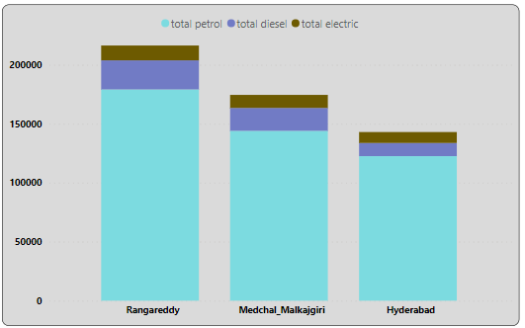
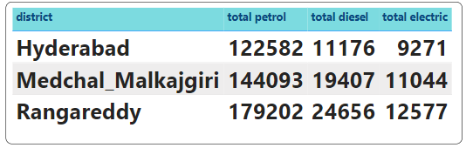
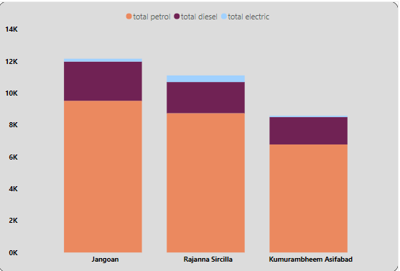
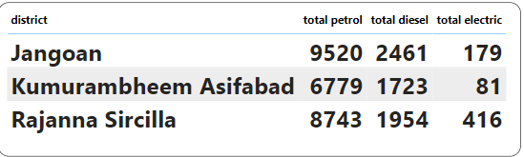
Top 3 Districts of vehicle sales 2022
Bottom 3 Districts of Vehicle sales 2022

Slide 22
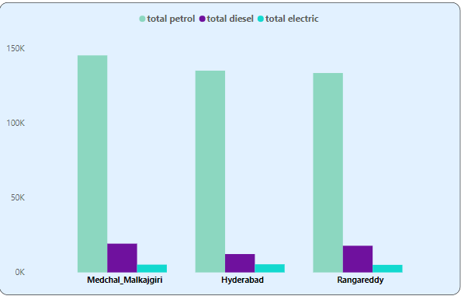
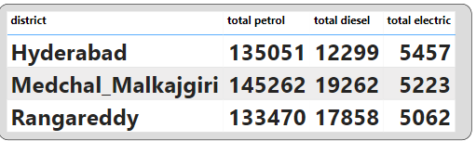
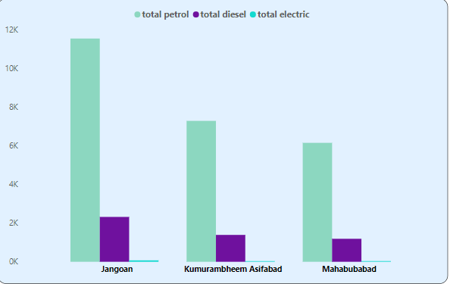
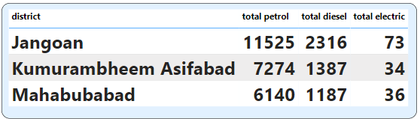
Top 3 districts of vehicle sales in 2021
Bottom 3 districts Vehicle sales in 2021

Slide 23

Ts-Ipass (TELANGANA STATE INDUSTRIAL PROJECT APPROVAL AND SELF CERTIFICATION SYSTEM

Slide 24

List down the top 5 sectors that have witnessed the most significant investments in FY 2022

Slide 25
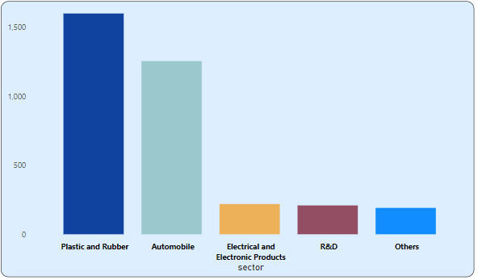
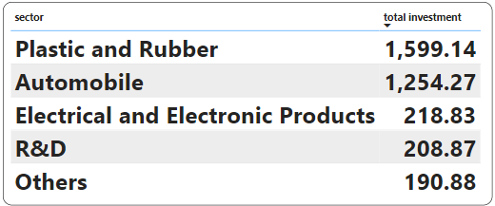
The top 5 sectors that have witnessed the most significant investments in FY 2022.

Slide 26
List down the top 3 districts that have attracted the most significant
sector investments during FY 2019 to 2022

Slide 27
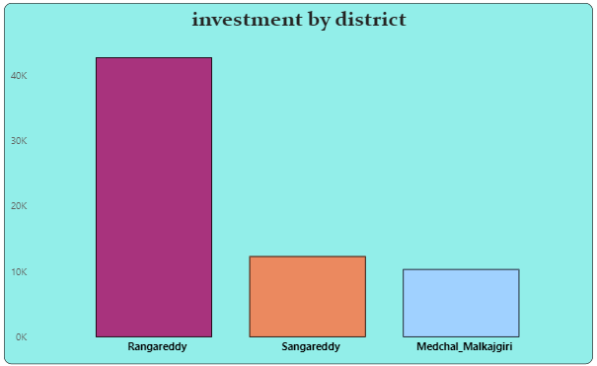
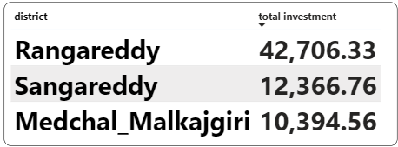
top 3 districts that have attracted the most significant sector investments during FY 2019 to 2022

Slide 28
Are there any particular sectors that have shown substantial growth in multiple districts in FY 2022?

Slide 29
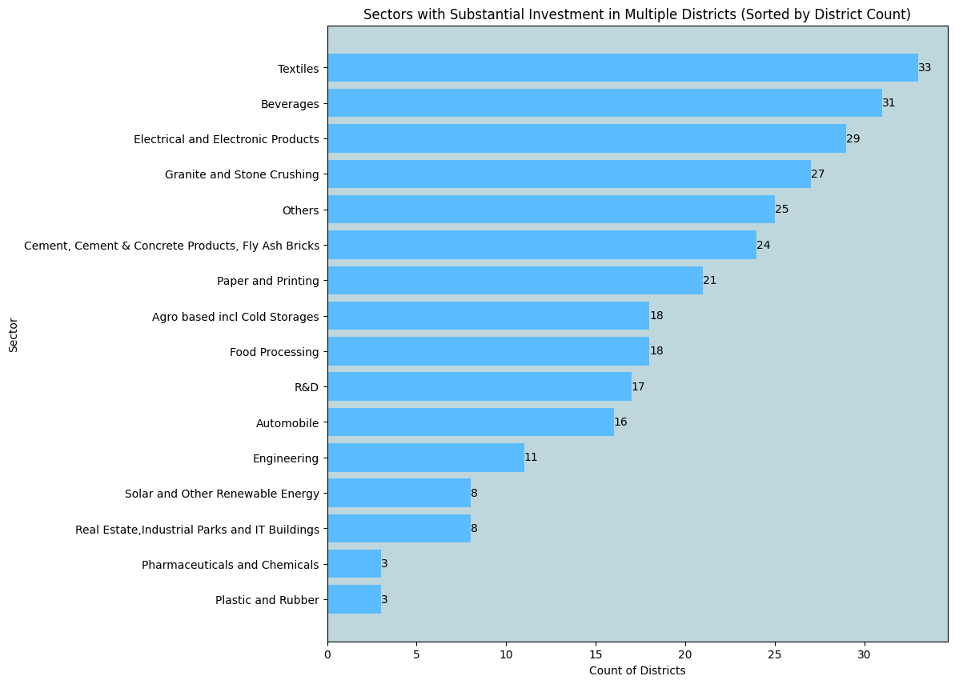
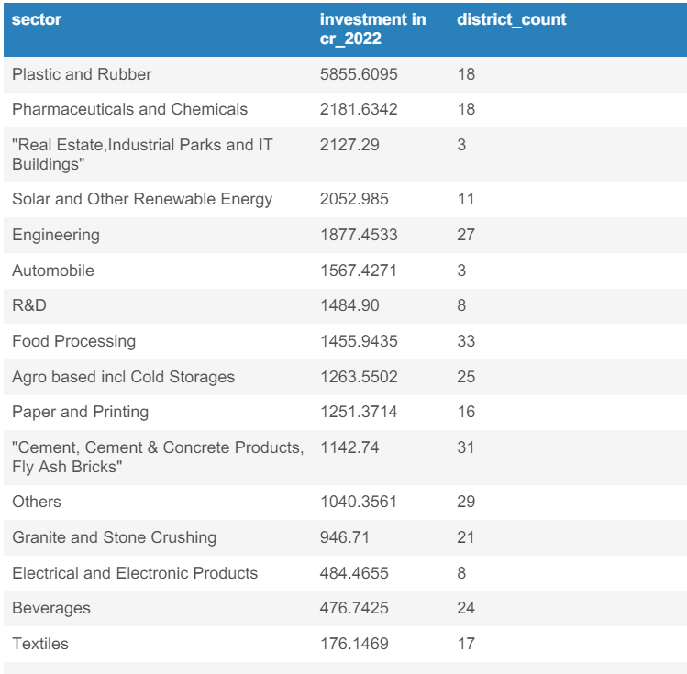
sectors that have shown substantial growth in multiple districts in FY 2022

Slide 30
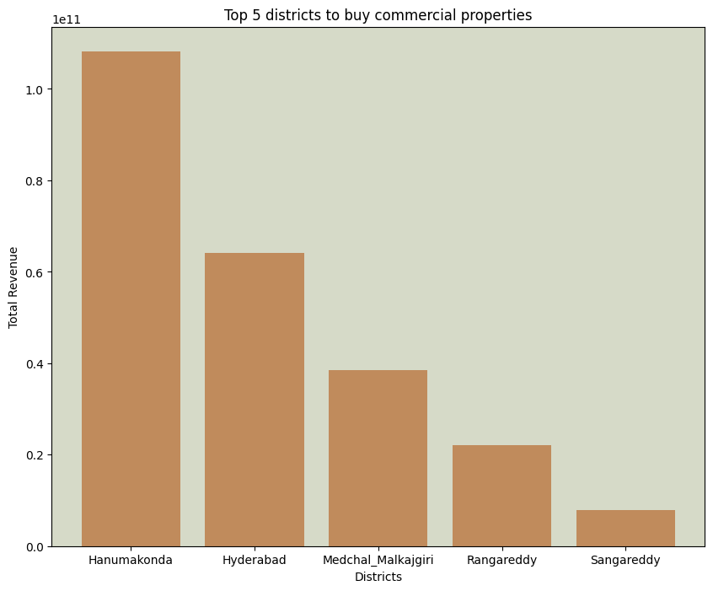
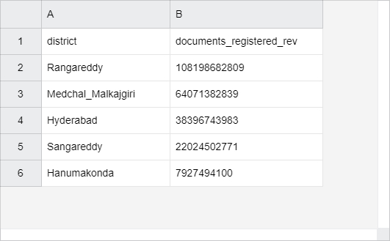
SECONDARY RESEARCH

Slide 31
significant government policies or initiatives were put into effect to enhance economic growth, investments, and employment in Telangana
Industrial Policy:
Telangana has enacted progressive industrial policies to promote industrialization and attract investments across various sectors. The state's industrial policy focuses on providing incentives, infrastructure support, and a conducive business environment to encourage the establishment of industries and businesses. Special incentives are offered to priority sectors such as IT/ITeS, pharmaceuticals, textiles, food processing, and renewable energy.
Information Technology (IT) and Innovation Policy:
Telangana has a robust IT and innovation policy aimed at fostering the growth of the IT and technology sectors. The policy emphasizes initiatives to promote entrepreneurship, innovation, research and development (R&D), and the creation of a skilled workforce in emerging technologies. Hyderabad, the state capital, is a major IT hub in India, and initiatives such as T-Hub (India's largest incubator for startups) and the Telangana State Innovation Cell support the growth of the startup ecosystem.
Employment Generation Schemes: The government of Telangana has implemented various schemes and programs to promote employment generation and skill development. Initiatives such as the Telangana State Employment Guarantee Scheme (TSEGS), Telangana Academy for Skill and Knowledge (TASK), and the Telangana State Skill Development Corporation (TSSDC) provide training and employment opportunities to youth and enhance their employability.
Mission Bhagiratha: This ambitious project aims to provide safe drinking water to every household in rural and urban areas of Telangana. It involves the construction of pipelines, water treatment plants, and storage facilities to ensure round-the-clock supply of clean drinking water.
Sector-specific Initiatives: Telangana has launched sector-specific initiatives to promote growth in key sectors such as textiles, pharmaceuticals, agriculture, and tourism. For example, the Textile and Apparel Policy aims to attract investments in textile manufacturing and garment production, while the Life Sciences Policy focuses on boosting the pharmaceutical and biotechnology sectors through incentives and support for R&D.

Slide 32
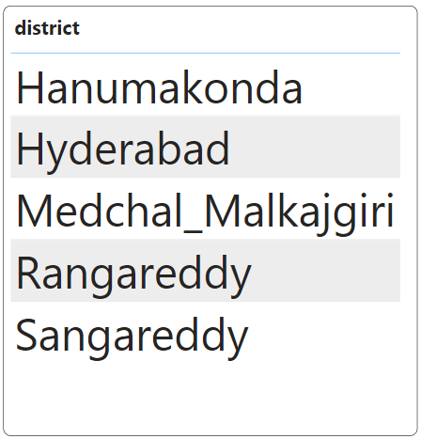
TOP 5 Insights
Top 5 Districts of Telangana

Slide 33
TOP 5 Insights
Total vehicle sales in Telangana
7 Million
Highest District vehicle sales
HYDERABAD

Slide 34
Highest preference of people for seat capacity
Seat capacity 1-3

Slide 35
Total number of employees
675K
Most number of sectors:
Real-estate and industrial parks,Buildings

Slide 36
Top 3 highest investment sectors
Real-estate and industrial parks, Buildings
Pharmaceuticals and Chemicals
Plastic and Rubber

Slide 37
THANK YOU

